Slide 1
Taxes, Estate & Succession Planning
Linda Mead – President & CEO - D&R Greenway Land Trust
Wade Martin – Managing Director – Financial Advisor

Slide 2
Live Off Your Land
Traditional financial planning tools used in innovative ways to preserve land can provide landowners with substantial estate and income tax benefits.
Depending on a landowner’s situation and specific needs, these tools can lower or eliminate:
Capital gains tax
Property tax
Roll back tax
Estate taxes for heirs
Income taxes through the use of charitable deductions

Slide 3
Land Preservation Methods
Agricultural Easement
Landowner continues ownership
May include residential area and working farm/ranch
Fee Simple Purchase or Outright Purchase
Deed transfers to Land Trust or other Public Entity
Could allow life rights for landowner/seller
Can be sold to future owner or bequested to children
Development rights permanently retired – stays as is
Greatest financial value to landowner; may require endowment donation

Slide 4
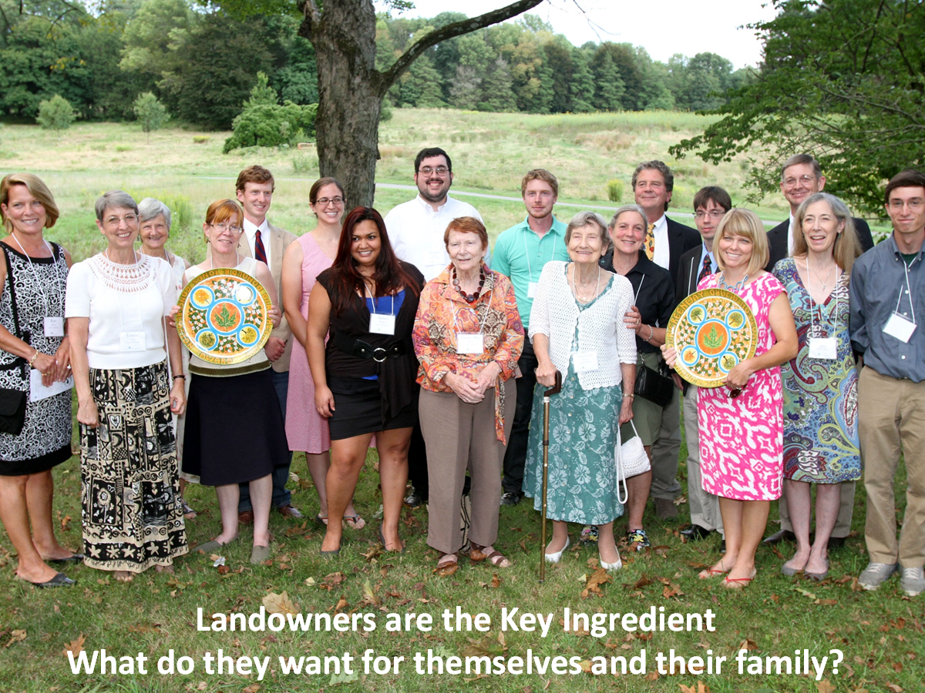
Princeton Nurseries

Slide 5
Objectives of Landowners
Objective | Solution
Needs income May be forced to sell but would prefer to stay on land | Sell land or development rights to land trust
Wants income and/or minimize taxes Wants to leverage value of the land | Sell land or development rights
Offset taxes (estate/income sources) Doesn’t need additional income and prefers preserving the property | Donate land or development rights
Offset taxes Wants to leverage value of the land | Sell or donate land or development rights

Slide 6

Land Preservation - Example
Mr. & Mrs. Smith’s house sits on 50 acres with 5-acre zoning. They could build 9 more houses on this property, but choose not to. They love the open space.
Lot 1
Lot 2
Lot 3
Lot 4
Lot 5
Lot 6
Lot 7
Lot 8
Lot 9
For Illustrative purposes only
The case study presented is provide for illustrative purposes only. Past performance is no guarantee of future results. The information has been obtained from sources we believe to be reliable, but we cannot guarantee its accuracy or completeness. These strategies do not guarantee a profit or protect against loss and may not be suitable for all investors. Each customer’s specific situation, goals and results may differ.

Slide 7
Land Preservation - Example
Preserved Lots 9
Retail Value x $300,000
Total Value of Land $2,700,000
Value After Easement - $ 270,000
($30,000 per lot)
Total Donated Value $2,430,000
Income Tax Rate x 35%
Tax Savings* $ 850,500
Client can deduct up to 50% of their AGI and carry forward for 15 years.
For illustrative purposes only.

Slide 8
Land Preservation - Example
No After
Easement Easement
Jones’ Income $500,000 $500,000
Less Deduction (50% AGI) -$ 0 -$250,000
Total AGI $500,000 $250,000
Income Tax Rate x 35% x 35%
Taxes $175,000 $ 87,500
Current Year Tax Savings - $87,500
Carry Forward - $2,180,000 for 15 years
For illustrative purposes only.

Slide 9
Development vs. Preservation
Challenge: Development offer of $22.7 million
Preservation Purchase Price: $14 million
ASSUMPTIONS | DEVELOPER | TOWN OFFER
Sale Price | $22,700,000 offered | $14,000,000
Rollback Tax (134 lots x $10,000 per year property tax x 3 years) | $4,020,000 | $0
Real Estate Commission 6% | $1,362,000 | $0
Time/Value of Money Based on 3 years for approvals (6% per year based on $22.7 million = 1,039,080 per year) | $3,117,240 | $0
NET SALE PROCEEDS before Capital Gains Tax and Charitable Deduction | $14,200,760 | $14,000,000
Charitable Deduction (22.7 – 14 = 8.7) |  | $8,700,000
Net after Charitable Deduction | $14,200,760 | $6,700,000
Approximate State (10%) and Federal (15%) Gains Tax | $3,550,190 | $1,675,000
Net after State and Federal Gains Tax | $10,650,570 | $5,025,000 + $8,700,000 = $13,725,000

Slide 10
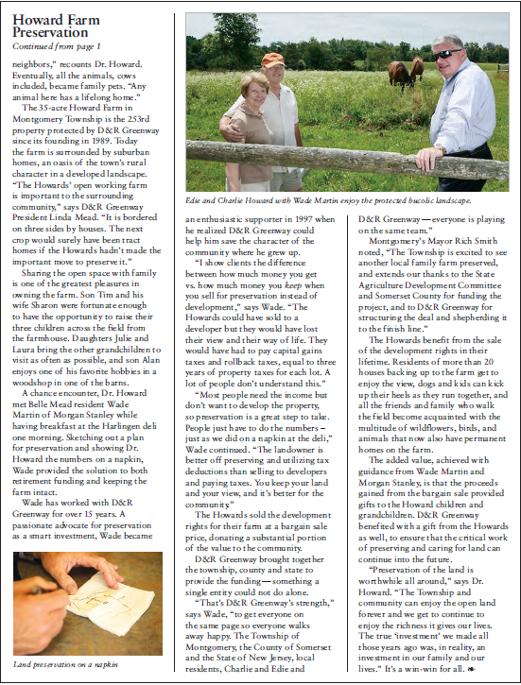
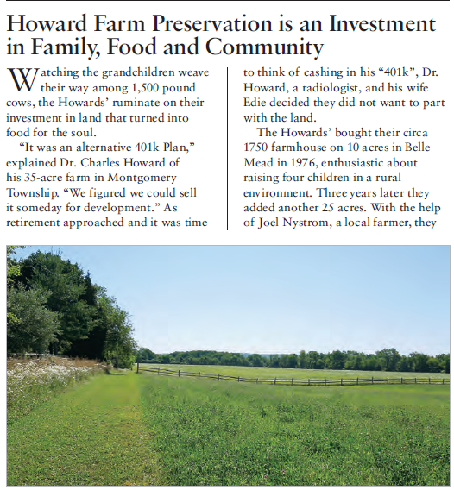

Slide 11
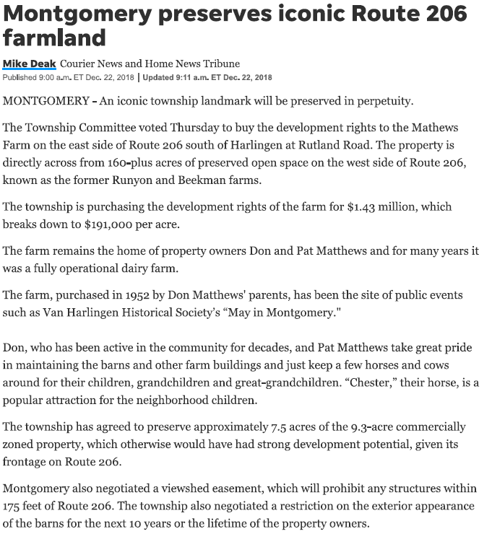
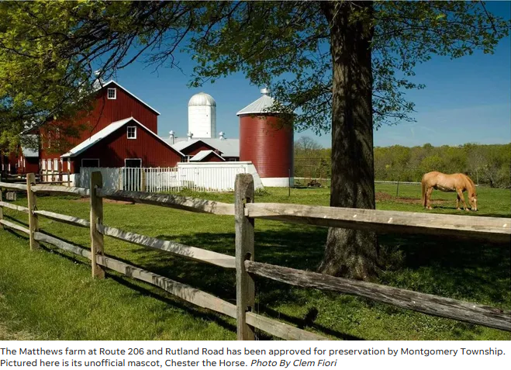
Matthews Farm Video

Slide 12
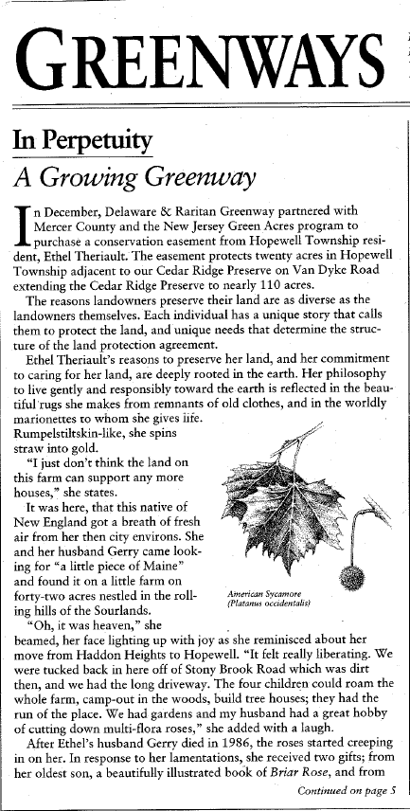
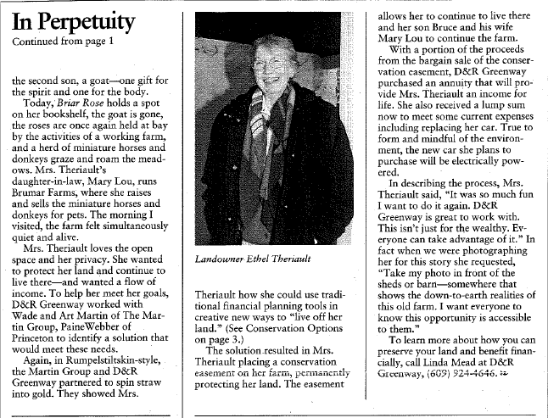

Slide 13
Contact Information
Linda Mead
President & CEO
D&R Greenway Land Trust
One Preservation Place
Princeton, New Jersey 08540
lmead@drgreenway.org
609-658-6519
Wade Martin Managing Director - Financial Advisor | Consulting Group
Martin Wealth Management Group RBC Wealth Management, a division of RBC Capital Markets, LLC 502 Carnegie Center, Suite 101
Princeton, NJ 08540 wade.martin@rbc.com
609-936-6411

